Slide 1
Final Topics
CS251 Fall 2021
(cs251.stanford.edu)
Dan Boneh
Invited talk final lecture. Final exam will be released this week.

Slide 2
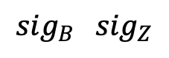
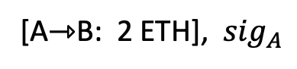
Quick Recap: zkRollup
rollup server
[A⇾B: 2 ETH], ${sig}_{A}$
L1 blockchain
(e.g. Ethereum)
atomic swap:
[B⇾Z: 1 ETH]
[Z⇾B: 2 BAT]
root
block 354
$${sig}_{B} {sig}_{Z}$$
Merkle Tree
Alice:
5 DAI
3 ETH
Bob:
2 ETH
Zoe:
1 ETH 3 BAT
Tx
…

Slide 3
Quick Recap: zkRollup
rollup server
[A⇾B: 2 ETH], ${sig}_{A}$
L1 blockchain
(verifies SNARK)
atomic swap:
[B⇾Z: 1 ETH]
[Z⇾B: 2 BAT]
new root
block 354
Tx data , SNARK
$${sig}_{B} {sig}_{Z}$$
Merkle Tree
block 357
Alice:
5 DAI
1 ETH
Bob:
3 ETH
2 BAT
Zoe:
2 ETH 1 BAT
Tx
…

Slide 4
Key points
The Rollup server stores all account balances
L1 chain does not store explicit balances
Rollup: Tx data written to L1 chain (16 gas per byte)
Validium: Tx data written to off-chain staked servers (cheaper)
why store Tx data?
… backup in case rollup server fails
Can we hide Tx data from the Rollup server and the public?
Yes! Using (zk)²-SNARKs
Notes:
EIP4488 proposal to reduce calldata cost to 3 gas per byte. 16 gas ≈ 1 ¢

Slide 5
A brief discussion of NFTs

Slide 6

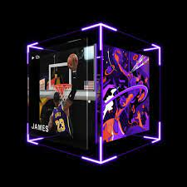
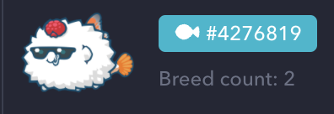
NFTs: managing digital assets
Example digital assets: (ERC-721)
Digital art: opensea, foundation
Collector items: NBA top shots
Game items: horses (zed.run), axies, …
Metaverse: ENS, plots in a virtual land
Why manage on a blockchain? Why not manage centrally?
Blockchain ensures long-term ownership, until sale.
Provides a trusted record of provenance (forgeries are evident)
#8857
NBA
Notes:
Opensea: Tx volume of $3.4 billion in August.
Importance of digital assets will likely grow over time.

Slide 7

Example: CryptoPunks
10,000 total CryptoPunks on Ethereum. Generated in 2017.
all offers and sales recorded on Ethereum (250 lines of Solidity)
visa
#7610
buy offer
sold!
sell offer
https://www.larvalabs.com/cryptopunks/details/7610
Notes:
24x24 picture. Not ERC-721
Snapshot of offers and sales.

Slide 8
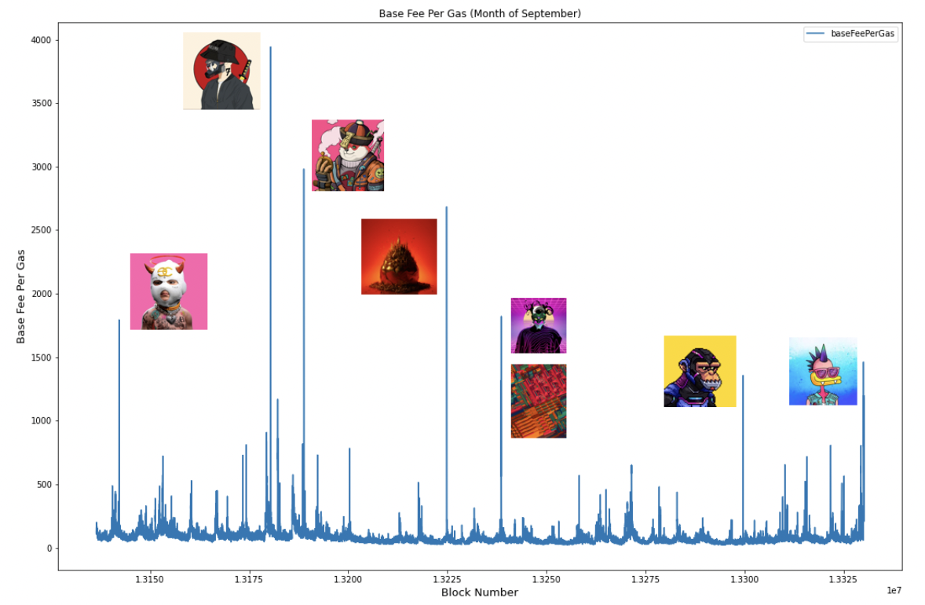
The resulting gas wars
Gas prices spike around highly-anticipated NFT launches:
… maybe don’t use first come first serve??
Base fee gas
Sep. 2021
https://www.paradigm.xyz/2021/10/a-guide-to-designing-effective-nft-launches/

Slide 9
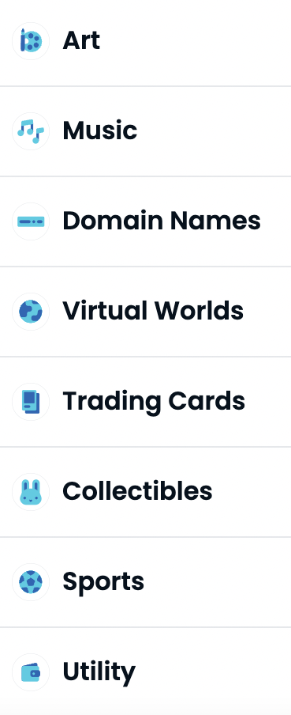

digital assets: where is this going?
NFTs are about managing ownership of general digital assets
Growing list of categories on OpenSea
What does ownership mean:
Where is item stored?
Where can it be displayed?
Who receives royalties on item: owner or creator?
Notes:
Utilities: e.g., proof of attendance. Royalties: ad revenues on display of item. Creator typically gets a cut from every downstream sale.

Slide 10
digital assets: where is this going?
NFTs and DeFi: asset-based DeFi:
Use NFT as collateral in loans (e.g., nftfi.com)
Fractional ownership of NFT assets (e.g., fractional.art)
NFT-based futures market
… all require a way to appraise an NFT (e.g., upshot.io)
Notes:
Royalties: ad revenues on display of item.

Slide 11
Many more topics to cover

Slide 12
Many more topics to cover …
(1) Maximal extractable value (MEV):
Recall: Ethereum v1 ⟹ all Tx enter a public mempool
Example MEV problem:
Tx
Tx
mempool
mempool
Tx: credit Bob
gasPrice: X
Tx’: credit Alice
gasPrice: 2X
(i) Trader Bob finds a liquidation opportunity on Compound,
(ii) Alice scans mempool, finds Bob’s Tx,
(iii) Alice issues Tx’ with higher gasPrice, scheduled first, and takes Bob’s profit
automated fontrunners ⟹ do this automatically
Notes:
Bob’s transaction is no longer valid, but he will still be charged gas.

Slide 13
Many more topics to cover …
(1) Maximal extractable value (MEV):
Recall: Ethereum v1 ⟹ all Tx enter a public mempool
Example MEV problem:
Tx
Tx
mempool
mempool
Tx: credit Bob
gasPrice: X
Tx: credit Alice
gasPrice: 2X
Miner’s revenues increase (MEV). Who gets hurt?
Bob. Leads to high gas prices on Ethereum, and other bad effects
What to do? Several answers: see, e.g., flashbots (mev-geth)
Notes:
Flashbots: private Tx in mempool, sealed bid gas auction for flashbot Tx. Also Optimism MEVA. More research to do.

Slide 14
Many more topics to cover …
(1) Maximal extractable value (MEV)
(2) On-chain Governance:
How to decide on updates to Uniswap, Compound, … ???
Current method:
Interested parties can buy governance tokens
One token one vote
Better mechanisms?

Slide 15
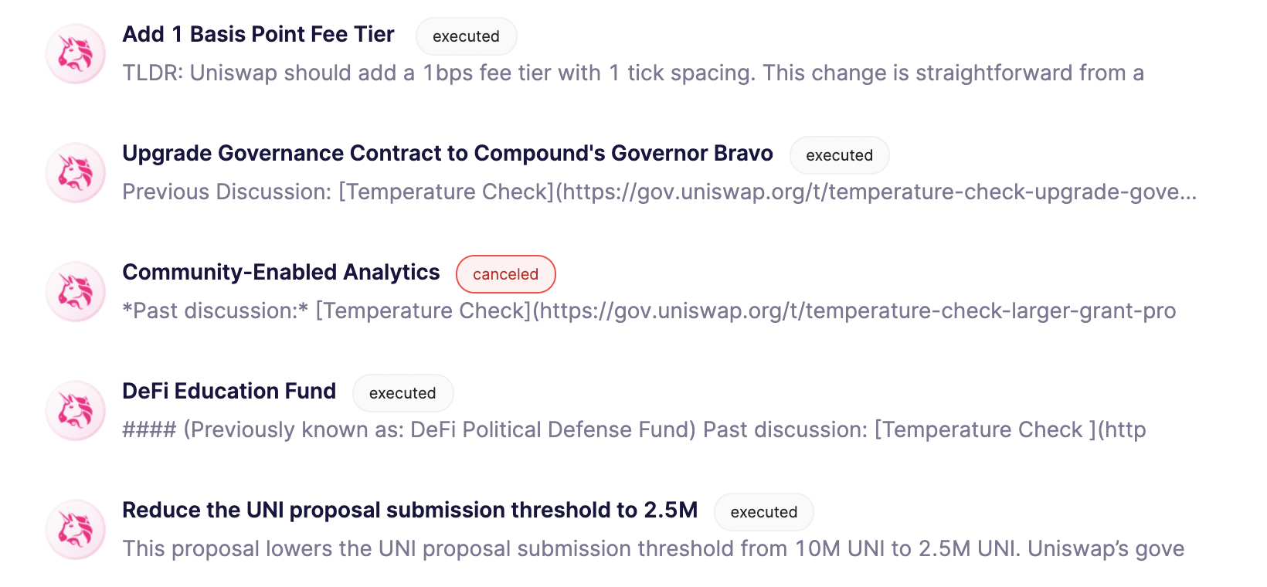
Example: Uniswap proposals

Slide 16
Many more topics to cover …
(1) Maximal extractable value (MEV)
(2) Project governance:
How to decide on updates to Uniswap, Compound, … ???
(3) Insurance: against bugs in Dapp code and other hacks
(4) Many more cute cryptography techniques (see slides at end)
(5) Interoperability between blockchains … discussed next

Slide 17
More topics …
Where can I learn more?
CS255 and CS355: Cryptography
EE374: Scaling blockchains with fast consensus
Stanford blockchain conference (SBC): Jan. 24-26, 2022.
Stanford blockchain club
Discussion: a career in blockchains? Where to start?

Slide 18
Bridging blockchains

Slide 19
Many L1 blockchains
Bitcoin: Bitcoin scripting language (with Taproot)
Ethereum: EVM. Currently: expensive Tx fees (better in Eth2)
EVM compatible blockchains: Celo, Avalanche, BSC, …
Higher Tx rate ⟹ lower Tx fees
EVM compatibility ⟹ easy project migration and user support
Other fast non-EVM blockchains: Solana, Flow, Algorand, …
Higher Tx rate ⟹ lower Tx fees
Notes:
User support on EVM-compatible chains: just use metamask by telling it to use a different network.

Slide 20




The problem: siloes
Flow
Solana
Ethereum
Serum DEX
Can I use Serum??
Bitcoin
Polkadot
How???
20 DOT
Notes:
Much like networking before the Internet

Slide 21
Interoperability
Interoperability:
User owns funds or assets (NFTs) on one blockchain system Goal: enable user to move assets to another chain
Composability:
Enable a DAPP on one chain to call a DAPP on another
Both are easy if the entire world used Ethereum
In reality: many blockchain systems that need to interoperate
The solution: bridges

Slide 22
A first example: BTC in Ethereum
How to move BTC to Ethereum ?? Goal: enable BTC in DeFi.
⟹ need new ERC20 on Ethereum pegged to BTC
(e.g., use it for providing liquidity in DeFi projects)
The solution: wrapped coins
Asset X on one chain appear as wrapped-X on another chain
For BTC: several solutions (e.g., wBTC, tBTC)

Slide 23
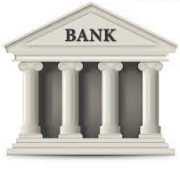
wBTC and tBTC: a lock-and-mint bridge
Let’s start with wBTC: moving 1 BTC to Ethereum
Alice on
Ethereum
Alice
1₿ verified
(signed)
1 ₿
mint 1 wBTC
credit Alice’s address
ERC20
1 ₿
1 ₿
custodian’s BTC address
bridge contract
1 wBTC
(lock 1 BTC)
to use in DeFi
(watch for deposits)
custodian

Slide 24

Alice wants her 1 BTC back
Moving 1 wBTC back to the Bitcoin network:
deduct 1 wBTC from Alice
Alice on
Ethereum
Alice
Bitcoin Tx
(signed)
1 ₿
burn my 1 wBTC
(signed)
1 ₿
1 ₿
custodian’s BTC address
bridge contract
(1 BTC unlocked)
(watch for burns)
custodian

Slide 25
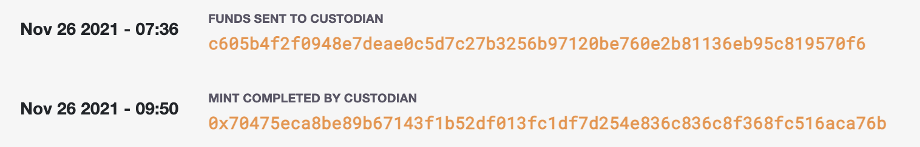
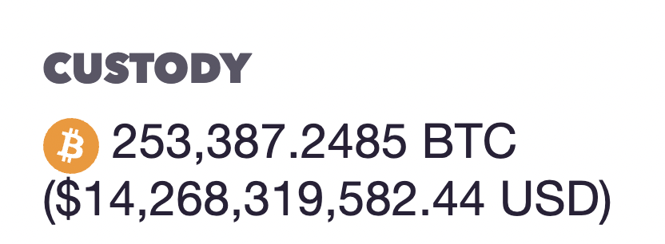
wBTC
Example BTC ⇾ Ethereum:
(Bitcoin Tx: ≈4,000 BTC)
(Ethereum Tx: )
Why two hours?
… make sure no Bitcoin re-org
Nov. 2021
The problem: trusted custodian
Can we do better?
Notes:
Custodian can run away with BTC, or require high redemption fees.

Slide 26
tBTC: no single point of trust
Alice requests to mint tBTC:
random three registered custodians are selected and they generate P2PKH Bitcoin address for Alice
signing key is 3-out-of-3 secret shared among three
(all three must cooperate to sign a Tx)
Alice sends BTC to P2PKH address, and received tBTC.
Custodians must lock 1.5x ETH stake for the BTC they manage
If locked BTC is lost, Alice can claim staked ETH on Ethereum.
Notes:
P2PKH: pay to public key hash.
3-out-of-3 threshold ECDSA: ensures no single party can steal UTXO deposit.
Not capital efficient.

Slide 27
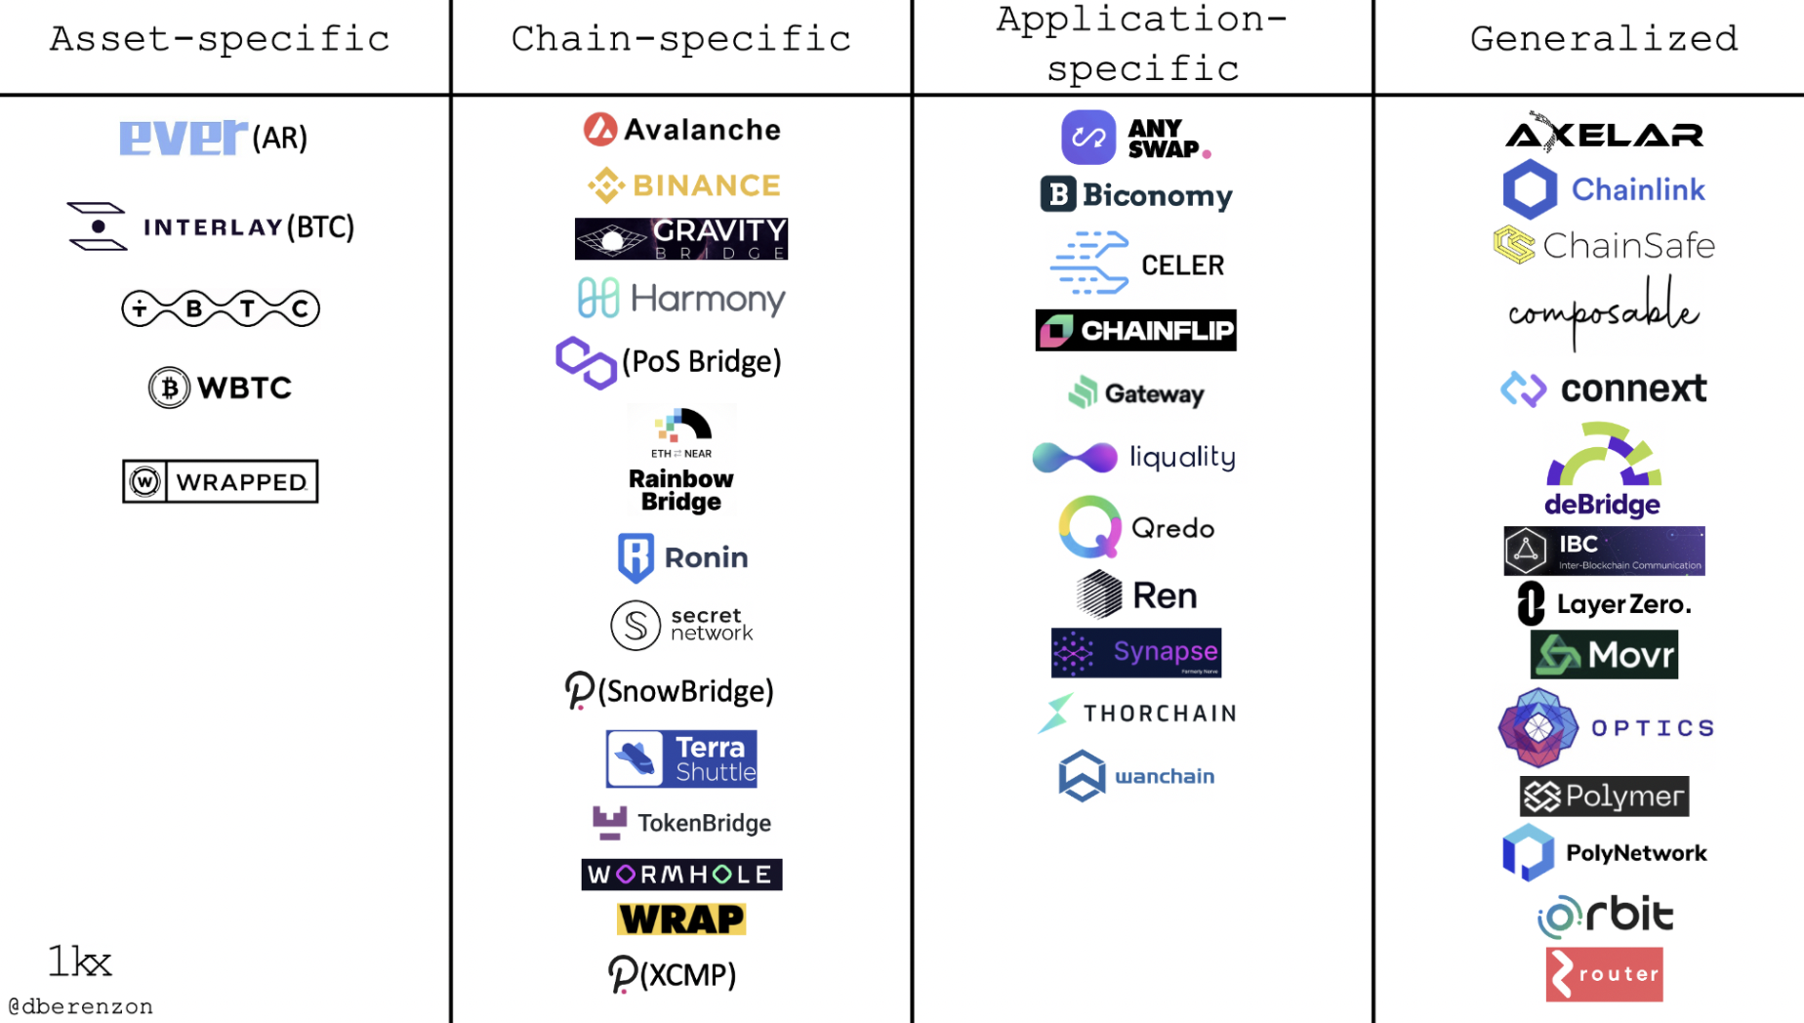
Bridging smart chains (with Dapp support)
A very active area:
Many super interesting ideas
https://medium.com/1kxnetwork/blockchain-bridges-5db6afac44f8

Slide 28
Two types of bridges
Type 1: a lock-and-mint bridge
SRC ⇾ DEST: user locks funds on SRC side, wrapped tokens are minted on the DEST side
DEST ⇾ SRC: funds are burned on the DEST side, and released from lock on the SRC Side
Type 2: a liquidity pool bridge
Liquidity providers provide liquidity on both sides
SRC ⇾ DEST: user sends funds on SRC side, equivalent amount released from pool on DEST side

Slide 29
Bridging smart chains (with Dapp support)
Step 1 (hard): a secure cross-chain messaging system
message to Y
on chain T: data
Source Chain S
DAPP-X
relayer
(contract)
I believe it
message from X
on chain S: data
Target Chain T
DAPP-Y
relayer
(contract)
Step 2 (easier): build a bridge using messaging system

Slide 30
Bridging smart chains (with Dapp support)
Step 1 (hard): a secure cross-chain messaging system
Source Chain S
Target Chain T
DAPP-X
DAPP-Y
Step 2 (easier): build a bridge using messaging system
DAPP-X ⇾ DAPP-Y: “I received 3 CELO, ok to mint 3 wCELO”
DAPP-Y ⇾ DAPP-X: “I burned 3 wCELO, ok to release 3 CELO”
If messaging system is secure, no one can steal locked funds at S
Notes:
… or “I received CryptoPunk#6587, ok to let Alice use it as collateral on chain T”

Slide 31
Primarily two types of messaging systems
(1) Externally verified: external parties verify message on chain S
verify sig and dispatch to recipients
collect msgs D[]
Relayer on S received messages D[] (signed)
Source Chain S
Target Chain T
relayerS
relayerT
Trustees (watch relayerS)
RelayerT dispatches only if all trustees signed
⟹ if DAPP-Y trusts trustees, it knows DAPP-X sent message
Notes:
This is a simplified version of Celo Optics.

Slide 32
Primarily two types of messaging systems
(1) Externally verified: external parties verify message on chain S
verify sig and dispatch to recipients
collect msgs D[]
Relayer on S received messages D[] (signed)
Source Chain S
Target Chain T
relayerS
relayerT
Trustees (watch relayerS)
What if trustees sign and post a fake message to relayerT?
off-chain party can send trustee’s signature to relayerS ⟹ trustee slashed
Notes:
What about replay attacks? Can also handle trustees that double-post a message to relayerT.

Slide 33

Primarily two types of messaging systems
(2) On-chain verified: chain T verifies block header of chain S
send messages D[] to relayerT,
along with finalized block header on chain S,
and Merkle proofs
verify and dispatch
receive msgs
Source Chain S
Target Chain T
relayerS
relayerT
oracle
no trustees
relayerT runs a (light) client for chain S to verify that relayerS received messages D[]
Notes:
Oracle is not really trusted because it is only relaying *finalized* blocks.

Slide 34
Primarily two types of messaging systems
SNARK
prover
verify SNARK proof and dispatch
msgs D[]
receive msgs
D[], BH, SNARK
Source Chain S
Target Chain T
relayerS
relayerT
block header (BH) and Merkle proofs
oracle
Problem: high gas costs on chain T to verify state of source chain.
Solution: use SNARKs ⟹ little work for relayerT
Notes:
Oracle is not really trusted because it is only relaying *finalized* blocks.

Slide 35
Bridging: the future vision
User can hold assets on any chain
Assets move cheaply and quickly from chain to chain
A project’s liquidity is available on all chains
Users and projects choose the chain that is best suited for their application and asset type
We are not there yet …

Slide 36
Fun crypto tricks

Slide 37
BLS signatures
one Bitcoin block
inputs
outputs
Signatures make up most of Tx data.
Can we compress signatures?
Yes: aggregation!
not possible for ECDSA
Tx1:
sig
sig
sig
Tx2:
sig
sig
sig
sig
Tx3:
sig
sig
Tx4:
sig
sig
sig

Slide 38
BLS Signatures
Used in modern blockchains: Ehtereum 2.0, Dfinity, Chia, etc.
The setup:
G = {1, g, …, g^{q-1}} a cyclic group of prime order q
H: M × G ⇾ G a hash function (e.g., based on SHA256)

Slide 39
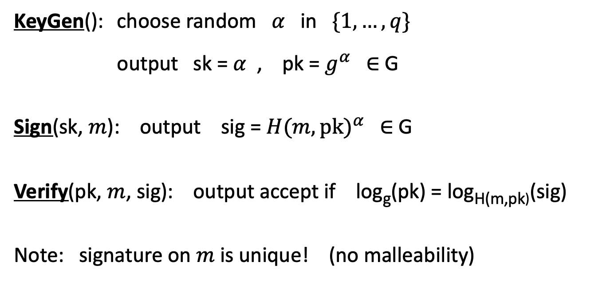
BLS Signatures
KeyGen(): choose random $α$ in $\{1, …, q\}$
output sk = $α$ , pk = $g^{α}$ ∈ G
Sign(sk, $m$): output sig = ${H(m,pk)}^{α}$ ∈ G
Verify(pk, $m$, sig): output accept if log_{g}(pk) = log_{H(m,pk)}(sig)
Note: signature on $m$ is unique! (no malleability)

Slide 40
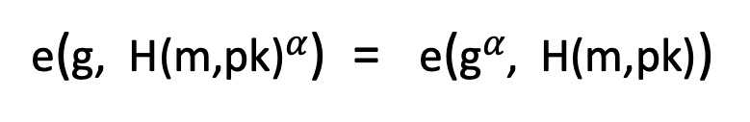
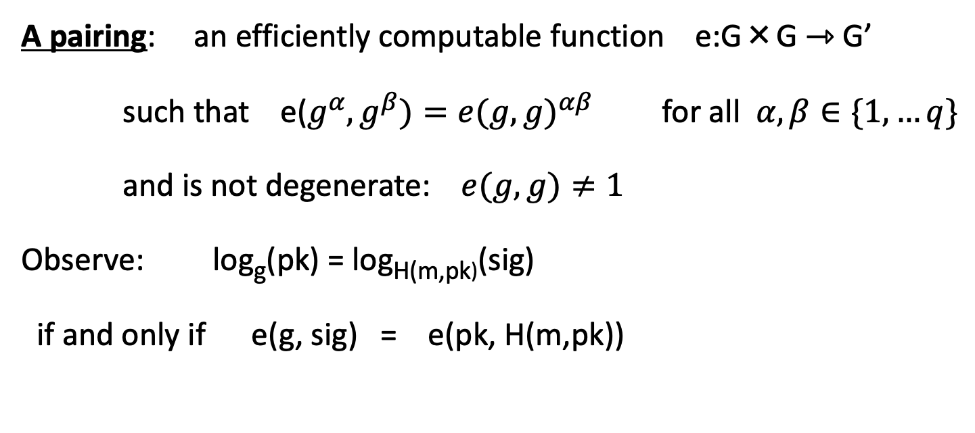
How does verify work?
A pairing: an efficiently computable function e:G×G ⇾ G’
such that e($g^{α},g^{β})={e(g,g)}^{αβ}$ for all $α,β∈\{1,…q\}$
and is not degenerate: $e(g, g)≠1$
Observe: log_{g}(pk) = log_{H(m,pk)}(sig)
if and only if e(g, sig) = e(pk, H(m,pk))
verify test
=
=
e(g, H(m,pk)$α$) = e(g$α$, H(m,pk))

Slide 41
Properties: signature aggregation [BGLS’03]
Anyone can compress n signatures into one
Verify( pk , m , σ* ) = “accept”
convinces verifier that for i=1,…,n: user i signed msg m_{i}
pk₁ , m₁ ⟶ σ₁
⋮
aggregate
⟶ σ*
pk_{n} , m_{n} ⟶ σ_{n}
single short signature

Slide 42
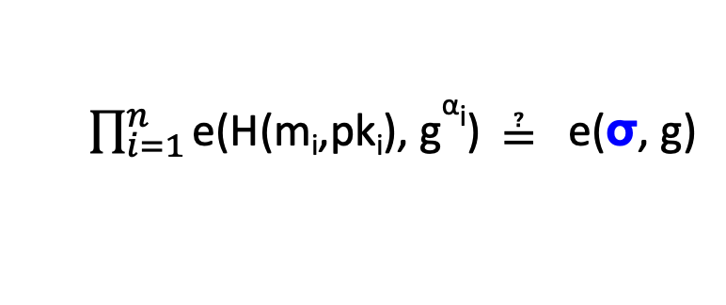
Aggregation: how
user 1: pk₁ = g^{α1} , m₁ ⟶ σ₁=H(m₁,pk₁)^{α1}
σ ⟵ σ₁⋯ σ_{n}
user n: pk_{n} = g^{αn} , m_{n} ⟶ σ_{n}=H(m_{n},pk_{n})^{αn}
Verifying an aggregate signature: (incomplete)
$\prod_{i=1}^{n}{\text{e}\text{(}\text{H}\text{(}\text{mi}\text{,}\text{pki}\text{), }\text{g}\text{α}\text{i}\text{)}}$ ≟ e(σ, g)
=
=
Π_{i=1} e(H(m_{i},pk_{i})^{αi}, g) = e(Π_{i=1}H(m_{i},pk_{i})^{αi}, g)

Slide 43
Compressing the blockchain with BLS
one Bitcoin block
if needed:
compress all signatures in a block into a single aggregate signatures
⇒ shrink block
or: aggregate in smaller batches
inputs
outputs
sig*
Tx1:
sig
sig
sig
Tx2:
sig
sig
sig
sig
Tx3:
sig
sig
Tx4:
sig
sig
sig

Slide 44
Reducing Miner State

Slide 45
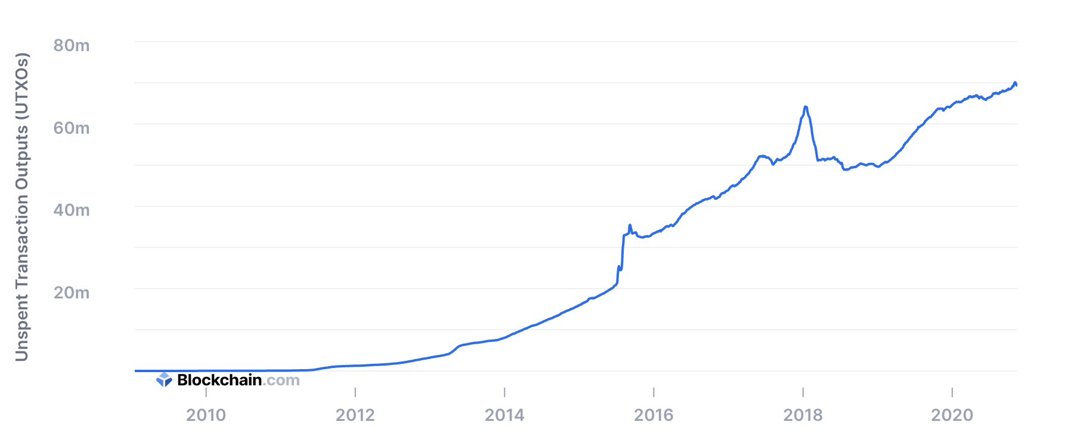
UTXO set size
≈70M UTXOs
Miners need to keep all UTXOs in memory to validate Txs
Can we do better?

Slide 46
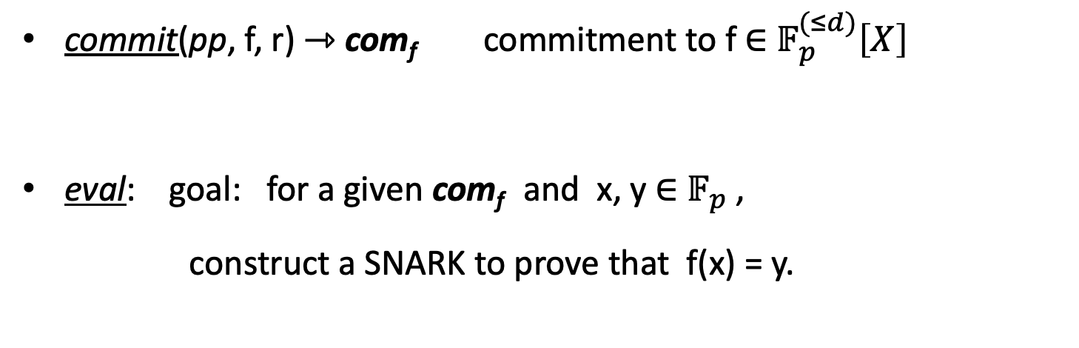
Recall: polynomial commitments
commit(pp, f, r) ⇾ com_{f} commitment to f ∈ $𝔽_{p}^{(≤d)}\left[X\right]$
eval: goal: for a given com_{f} and x, y ∈ $𝔽_{p}$,
construct a SNARK to prove that f(x) = y.

Slide 47
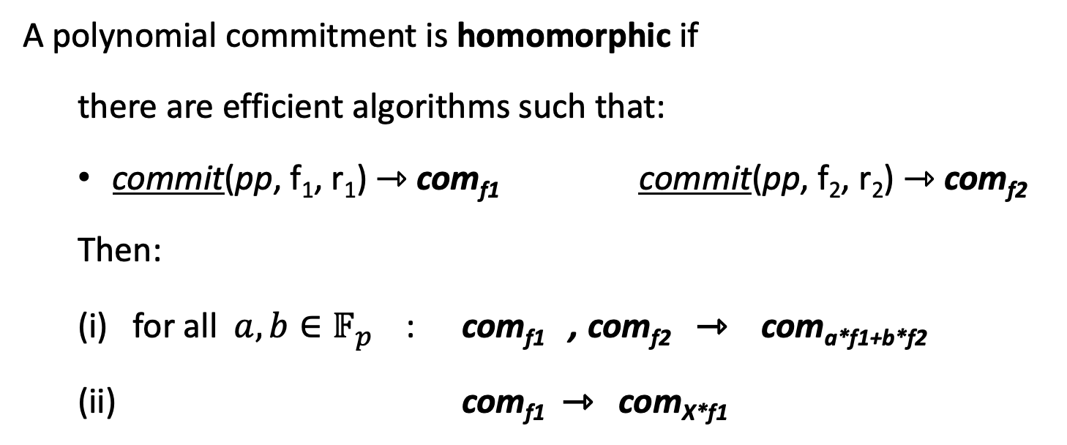
Homomorphic polynomial commitment
A polynomial commitment is homomorphic if
there are efficient algorithms such that:
commit(pp, f₁, r₁) ⇾ com_{f1} commit(pp, f₂, r₂) ⇾ com_{f2}
Then:
(i) for all $a, b∈𝔽_{p}^{}$ : com_{f1} , com_{f2} ⇾ com_{a*f1+b*f2}
(ii) com_{f1} ⇾ com_{X*f1}

Slide 48
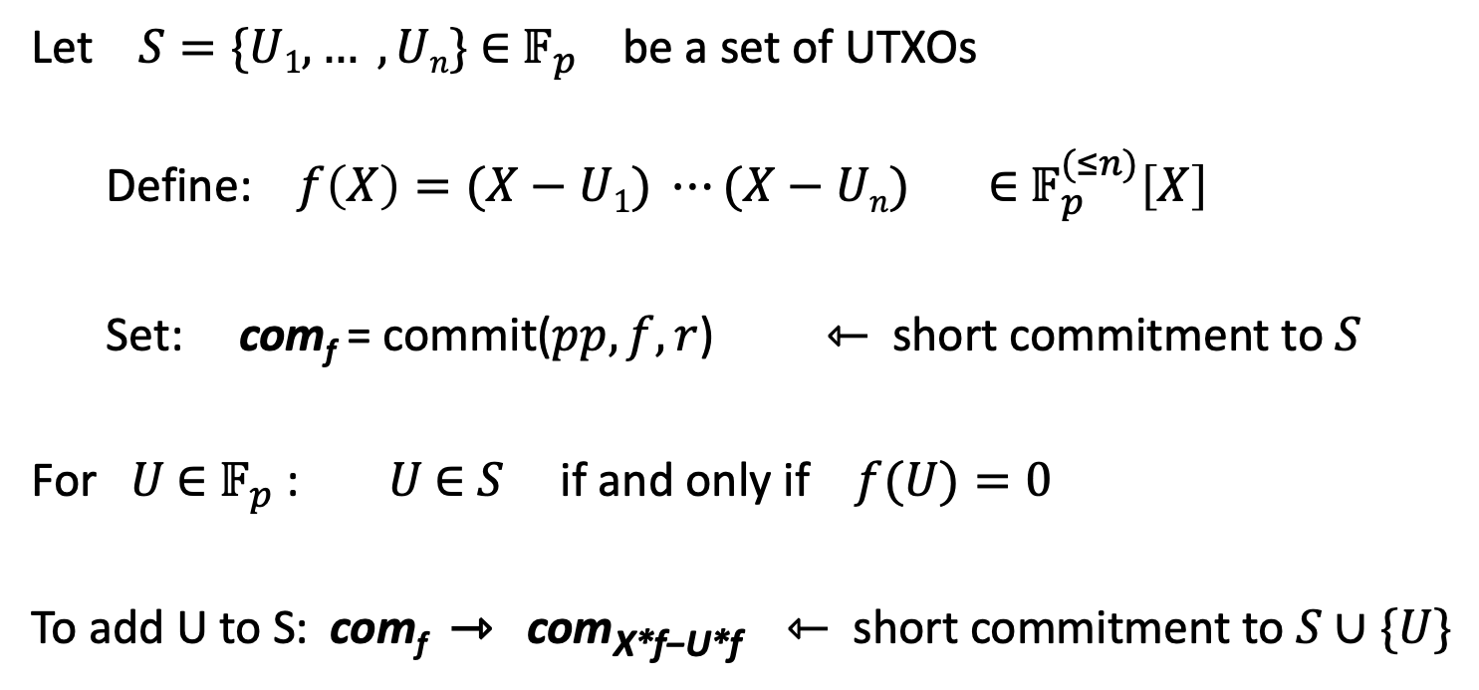
Committing to a set (of UTXOs)
(accumulator)
Let $S=\{U1, … , Un\}$ ∈ $𝔽_{p}$ be a set of UTXOs
Define: $f\left(X\right)=(X−U1) ⋯(X−Un)$ ∈ $𝔽_{p}^{(≤n)}\left[X\right]$
Set: com_{f} = commit($pp, f, r$) ⇽ short commitment to $S$
For $U$ ∈ $𝔽_{p}$ : $U$ ∈ $S$ if and only if $f(U)=0$
To add U to S: com_{f} ⇾ com_{X*f−U*f} ⇽ short commitment to $S∪\{U\}$

Slide 49
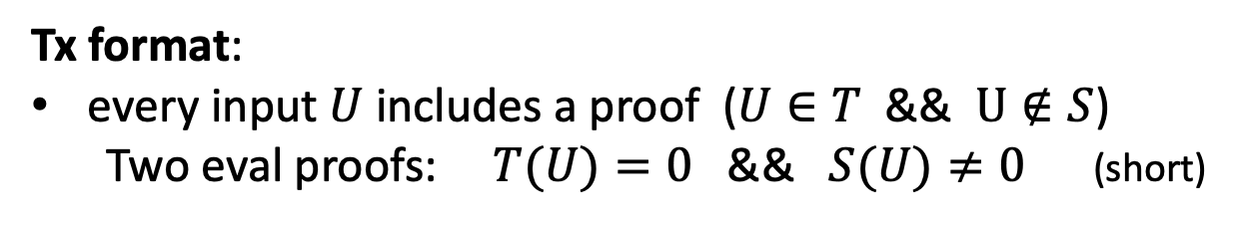
How does this help?
Miners maintain two commitments:
(i) commitment to set T of all UTXOs
(ii) commitment to set S of spent TXOs
≤ 1KB
com_{T}, com_{S}
Tx format:
every input $U$ includes a proof ($U∈T$ && $U∉S$)
Two eval proofs: $T(U)=0$ && $S(U)≠0$ (short)
Tx processing: miners check eval proofs, and if valid,
add inputs to set S and outputs to set T. That’s it!

Slide 50


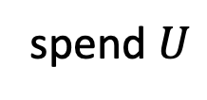
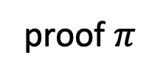
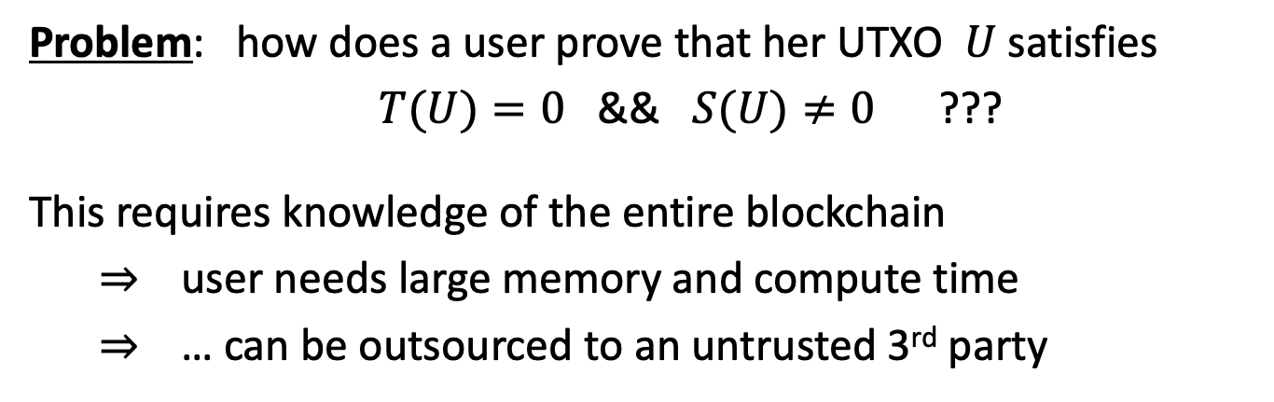
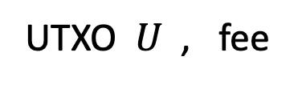
Does this work ??
Problem: how does a user prove that her UTXO $U$ satisfies
$T(U)=0$ && $S(U)≠0$ ???
This requires knowledge of the entire blockchain
⇒ user needs large memory and compute time
⇒ … can be outsourced to an untrusted 3rd party
UTXO $U$ , fee
polynomials
S and T
proof $π$
spend $U$
The proof factory

Slide 51
Is this practical?
Not quite …
Problem: the factory’s work per proof is linear in the number of UTXOs ever created
Many variations on this design:
can reduce factory’s work to log₂(# current UTXOs) per proof
Factory’s memory is linear in (# current UTXOs)
End result: outsource memory requirements to a small number of 3rd party service providers
Notes:
factory work is logarithmic by using 2-3 trees.

Slide 52
Taproot: semi-private scripts in Bitcoin

Slide 53
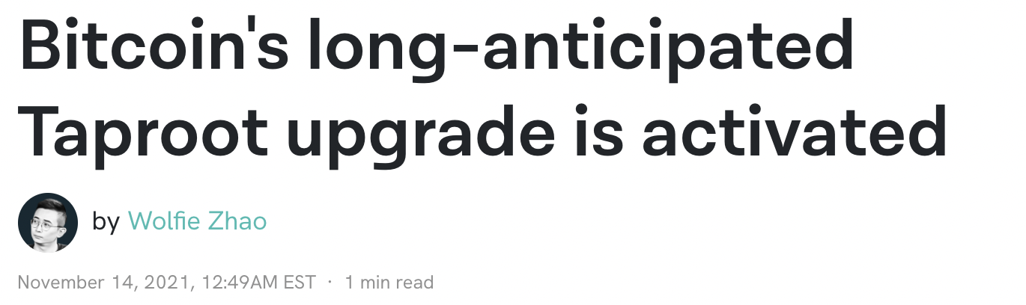
Taproot is here …

Slide 54
Script privacy
Currently: Bitcoin scripts must be fully revealed in spending Tx
Can we keep the script secret?
Answer: Yes, easily! when all goes well …

Slide 55
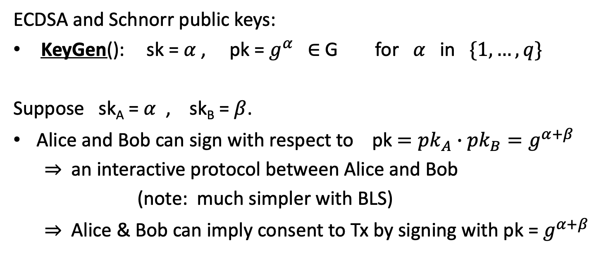
How?
ECDSA and Schnorr public keys:
KeyGen(): sk = $α$ , pk = $g^{α}$ ∈ G for $α$ in $\{1, …, q\}$
Suppose sk_{A} = $α$ , sk_{B} = $β$.
Alice and Bob can sign with respect to pk $={pk}_{A}∙{pk}_{B}=g^{α+β}$
⇒ an interactive protocol between Alice and Bob
(note: much simpler with BLS)
⇒ Alice & Bob can imply consent to Tx by signing with pk = $g^{α+β}$

Slide 56
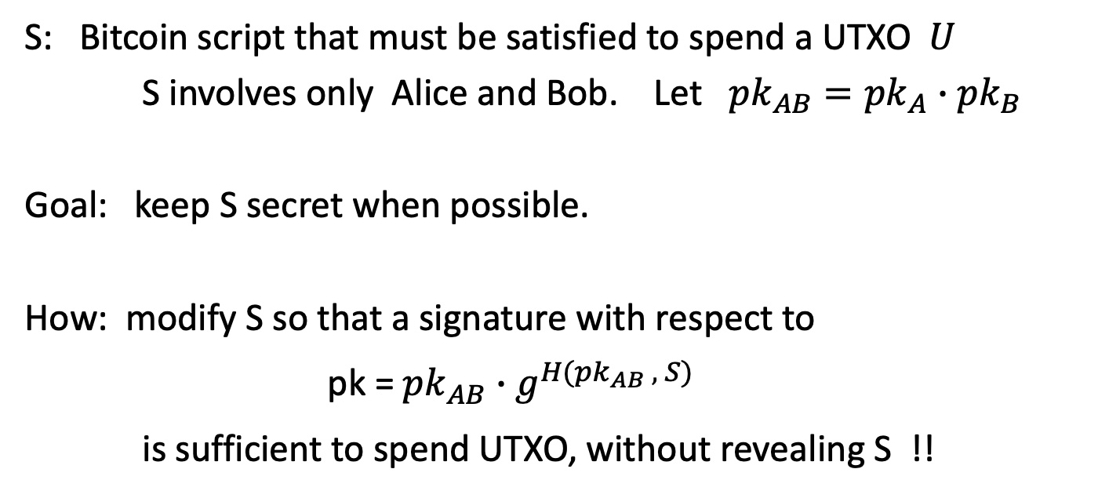
How?
S: Bitcoin script that must be satisfied to spend a UTXO $U$
S involves only Alice and Bob. Let ${pk}_{AB}={pk}_{A}∙{pk}_{B}$
Goal: keep S secret when possible.
How: modify S so that a signature with respect to
pk =${pk}_{AB}∙$ $g^{H({pk}_{AB} , S)}$
is sufficient to spend UTXO, without revealing S !!

Slide 57
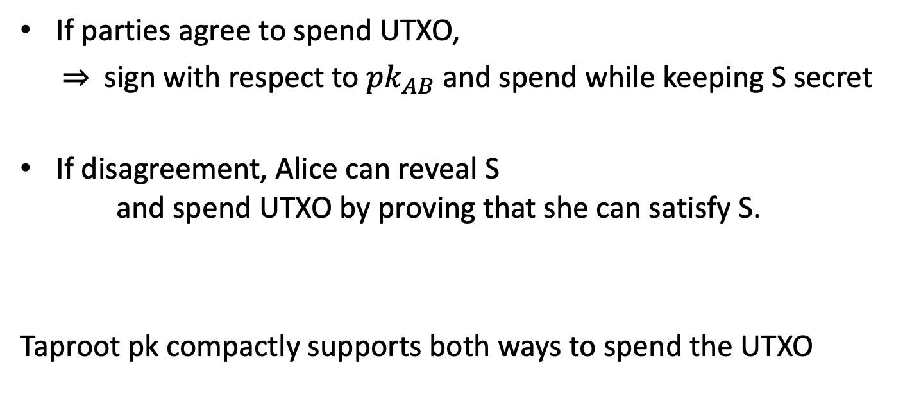
The main point
If parties agree to spend UTXO,
⇒ sign with respect to ${pk}_{AB}$ and spend while keeping S secret
If disagreement, Alice can reveal S and spend UTXO by proving that she can satisfy S.
Taproot pk compactly supports both ways to spend the UTXO

Slide 58
END OF LECTURE
Next lecture: super cool final guest lecture
Notes:
Olaf

